Slide 1
Final Project Rinkal raj
Data Cleaning & analyzing & EDA
Tableau for visualization
Building a various Machine Learning
Model & Flask app
Use CSV For data collection

Slide 2
Heart Failure Prediction Dataset
Heart diseases (CVDs) are the number 1 cause of death globally, taking an estimated 17.9 million lives each year, which accounts for 31% of all deaths worldwide. Heart failure is a common event caused by CVDs and this dataset contains 11 features that can be used to predict a possible heart disease.
Age: age of the patient [years]
Sex: sex of the patient [M: Male, F: Female]
ChestPainType: chest pain type [TA: Typical Angina, ATA: Atypical Angina, NAP: Non-Anginal Pain, ASY: Asymptomatic]
RestingBP: resting blood pressure [mm Hg]
Cholesterol: serum cholesterol [mm/dl]
FastingBS: fasting blood sugar [1: if FastingBS > 120 mg/dl, 0: otherwise]
RestingECG: resting electrocardiogram results [Normal: Normal, ST: having ST-T wave abnormality (T wave inversions and/or ST elevation or depression of > 0.05 mV), LVH: showing probable or definite left ventricular hypertrophy by Estes' criteria]
MaxHR: maximum heart rate achieved [Numeric value between 60 and 202]
ExerciseAngina: exercise-induced angina [Y: Yes, N: No]
Oldpeak: oldpeak = ST [Numeric value measured in depression]
ST_Slope: the slope of the peak exercise ST segment [Up upsloping, Flat: flat, Down: downsloping]
HeartDisease: output class [1: heart disease, 0: Normal]

Slide 3
Project/Goals
The main goal of this project is to predict patient has heart disease or not using a heart dataset.
The project involved the main stages: data preprocessing, analysis using Python, generating various machine learning models, Flask app, and visualization using Tableau.
The ultimate goal was to gain insights and communicate findings regarding heart disease affects variables patterns, and other relevant aspects of the dataset.
The Created Flask application that predicts patient has heart disease or not which takes JSON data formats and generates prediction.

Slide 4



Tool Installation & Set Up
Use Visual Studio Code Python Programing and Editing file which clone from GitHub.
Use Tableau to create visualization and explore the relationship between variables.
Use GitHub for storing files of project data and share on local server it is easy way to access and store data.

Slide 5

Data Cleaning

Slide 6
Ensure Accurate Datatypes
Address Missing Values
Remove Unwanted or Irrelevant Observations
Data Cleaning
Fixing Typos
Notes:
When conducting research, it is easy to go to one source: Wikipedia. However, you need to include a variety of sources in your research. Consider the following sources:
Who can I interview to get more information on the topic?
Is the topic current and will it be relevant to my audience?
What articles, blogs, and magazines may have something related to my topic?
Is there a YouTube video on the topic? If so, what is it about?
What images can I find related to the topic?

Slide 7
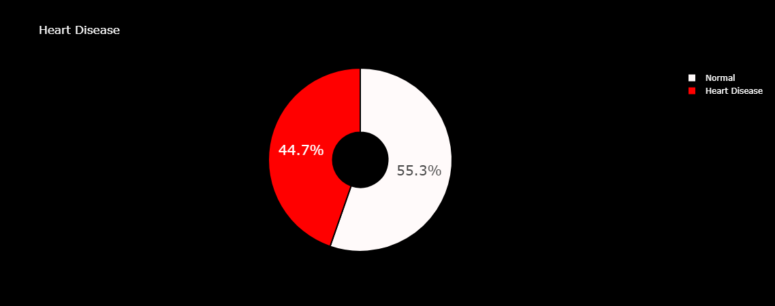
EDA
The distribution of data of patients having heart disease or not from the dataset.

Slide 8
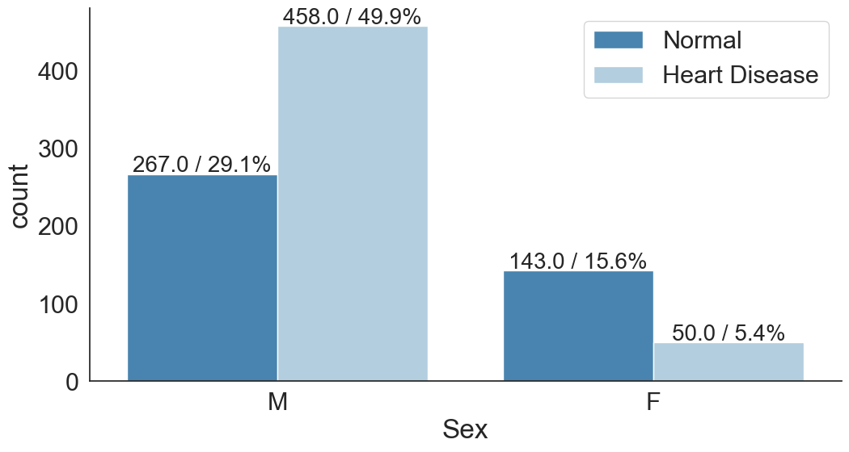
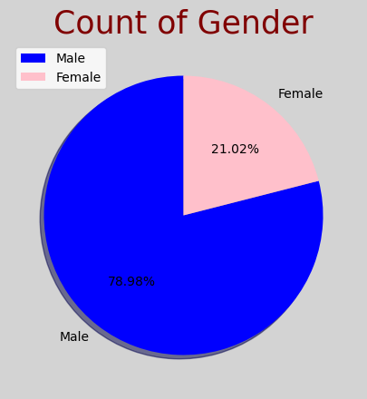
Comparison between males and females who suffer from heart disease and normal.

Slide 9
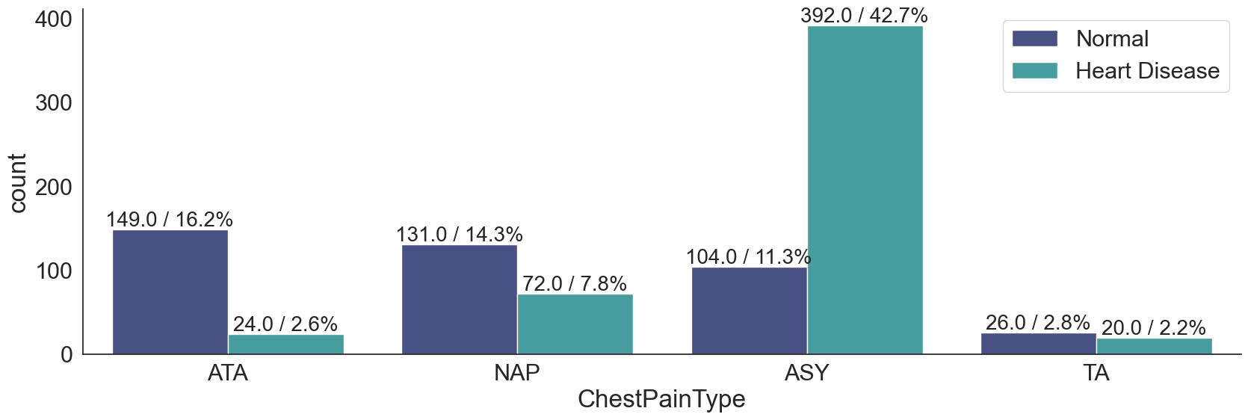
Comparing chest pain type which chest pain is high when a patient has heart disease.

Slide 10
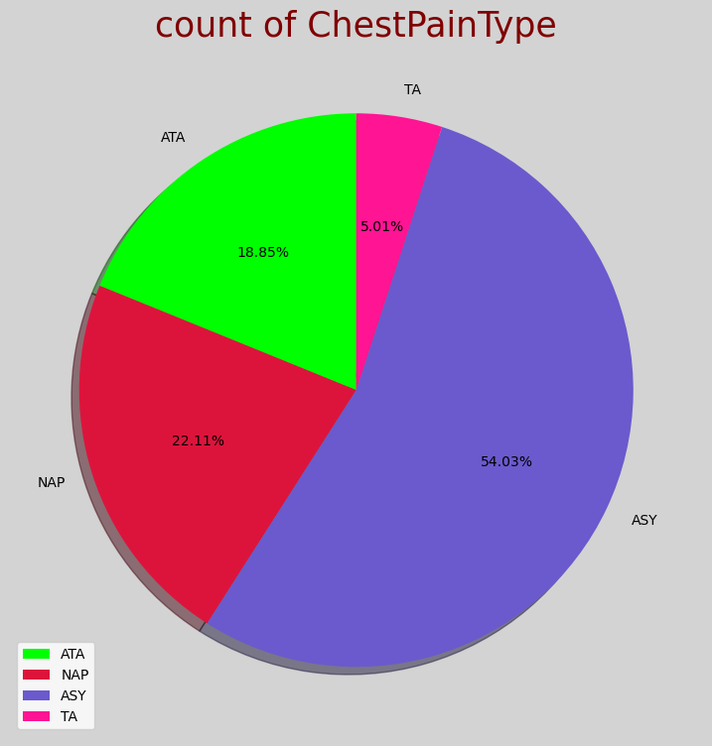
Percentage Distribution of chest pain types.

Slide 11
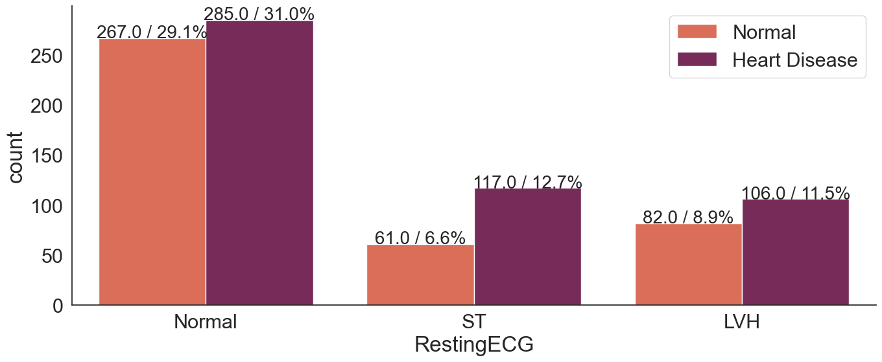
Comparing three types of RestingECG.

Slide 12
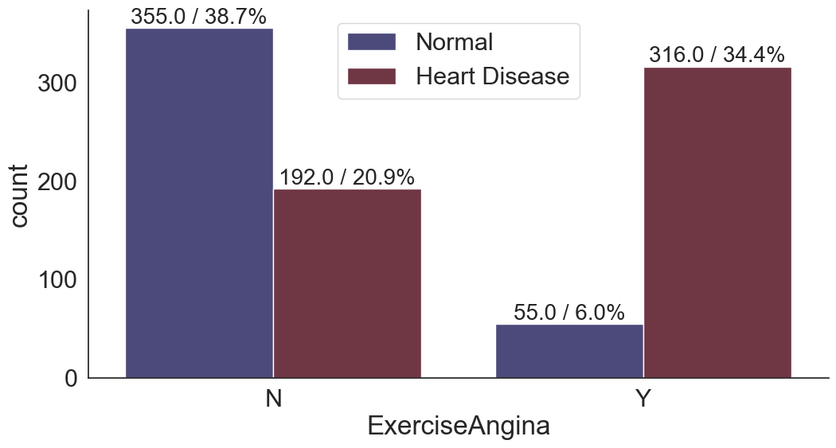
Comparing data with patients who doing exercise or not.

Slide 13
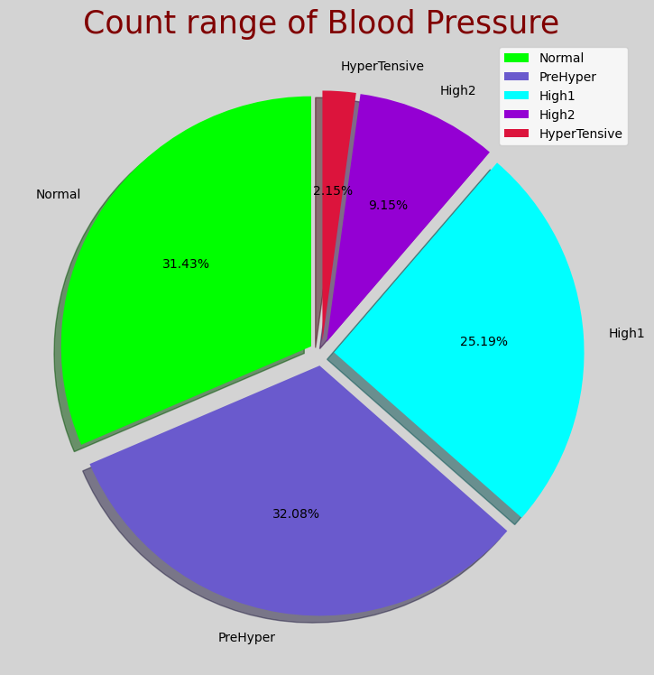
Distribution of blood Pressure types.

Slide 14
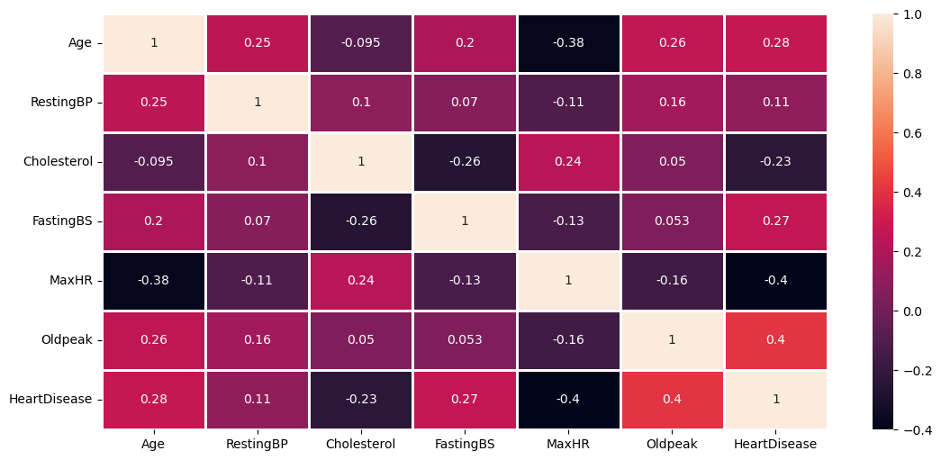
Co-Relation between variables through using heat map.

Slide 15
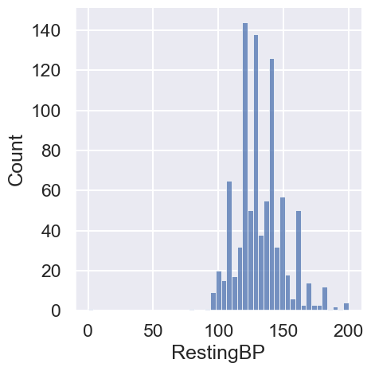
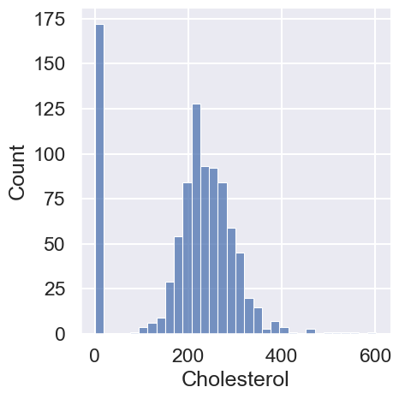
Outliners

Slide 16
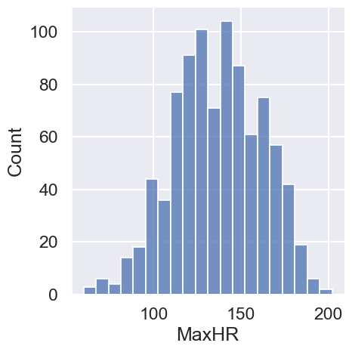
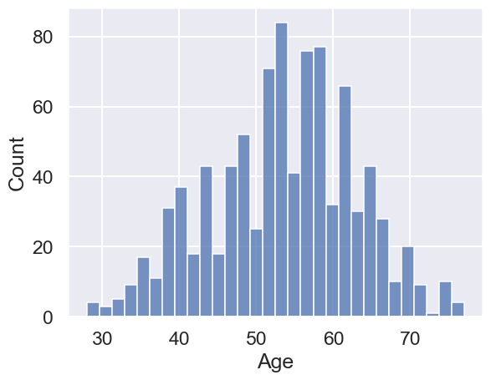
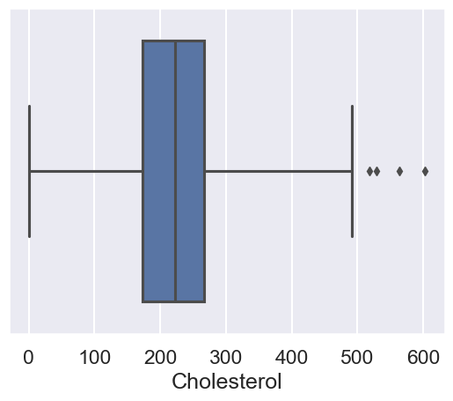

Slide 17
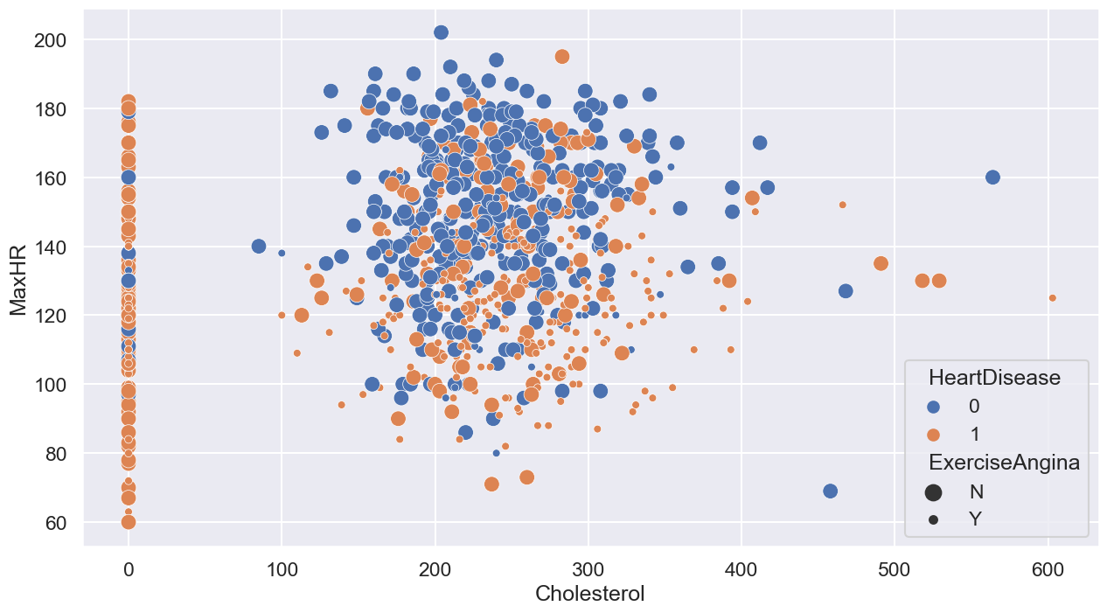
Relation Between variables

Slide 18
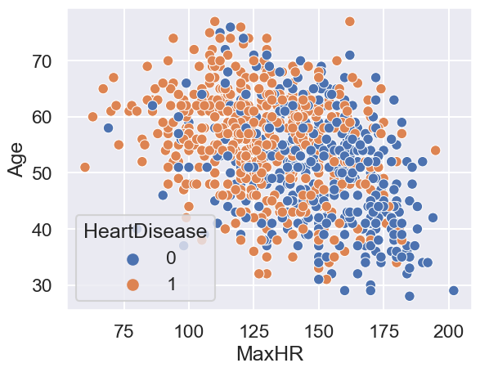
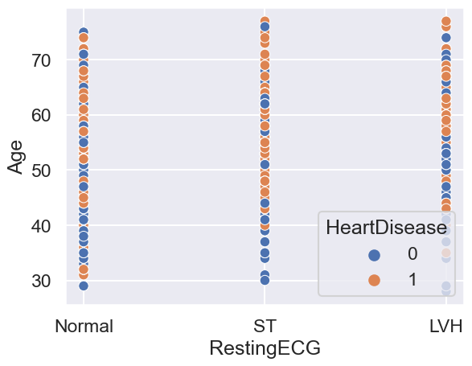

Slide 19
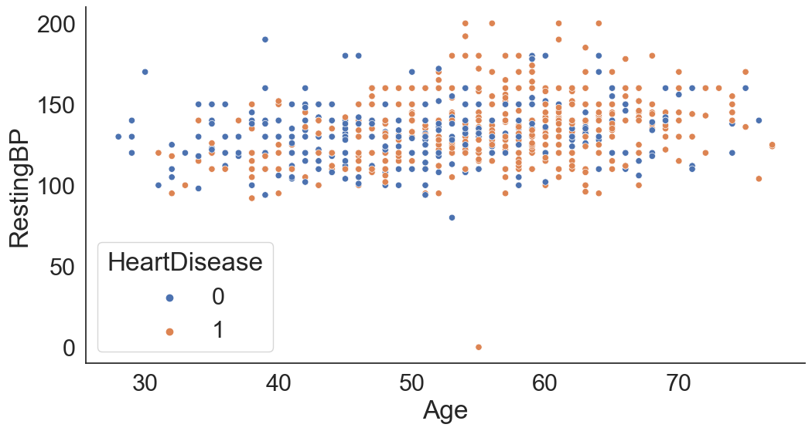

Slide 20
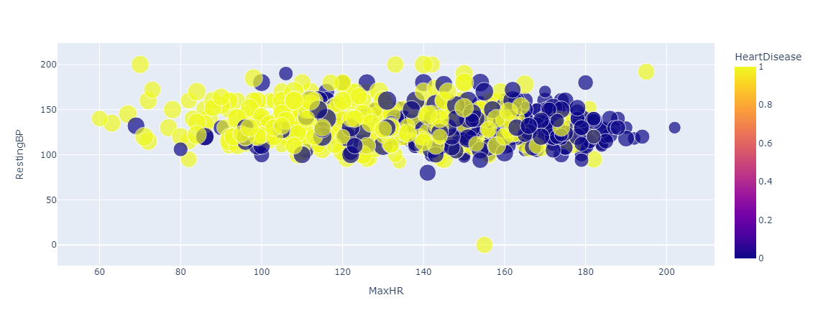

Slide 21
Static Model
Hypothesis: The presence of heart disease (heart disease = 1) is influenced by various factors such as age, sex, chest pain type, resting blood pressure, cholesterol level, fasting blood sugar, resting electrocardiogram results, maximum heart rate achieved, exercise-induced angina, old peak (ST depression), and the slope of the peak exercise ST segment.

Slide 22
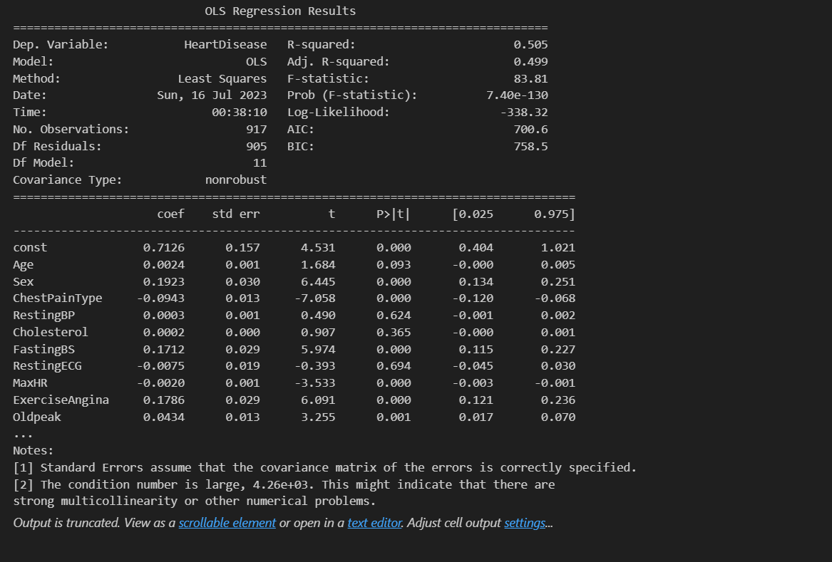

Slide 23
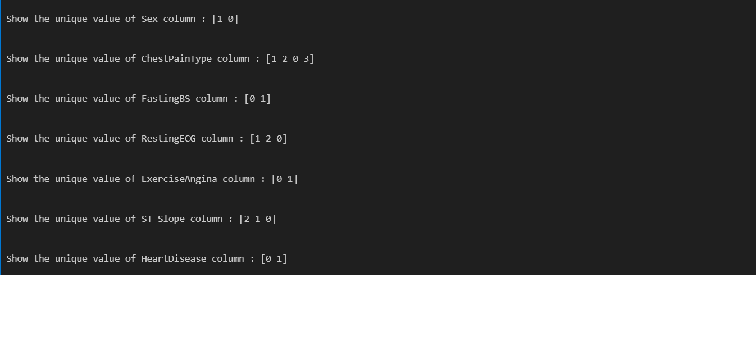
Machine Learning Classification Model
Convert Categorial data to Numeric data using the LabelEncoder Function of Python.

Slide 24
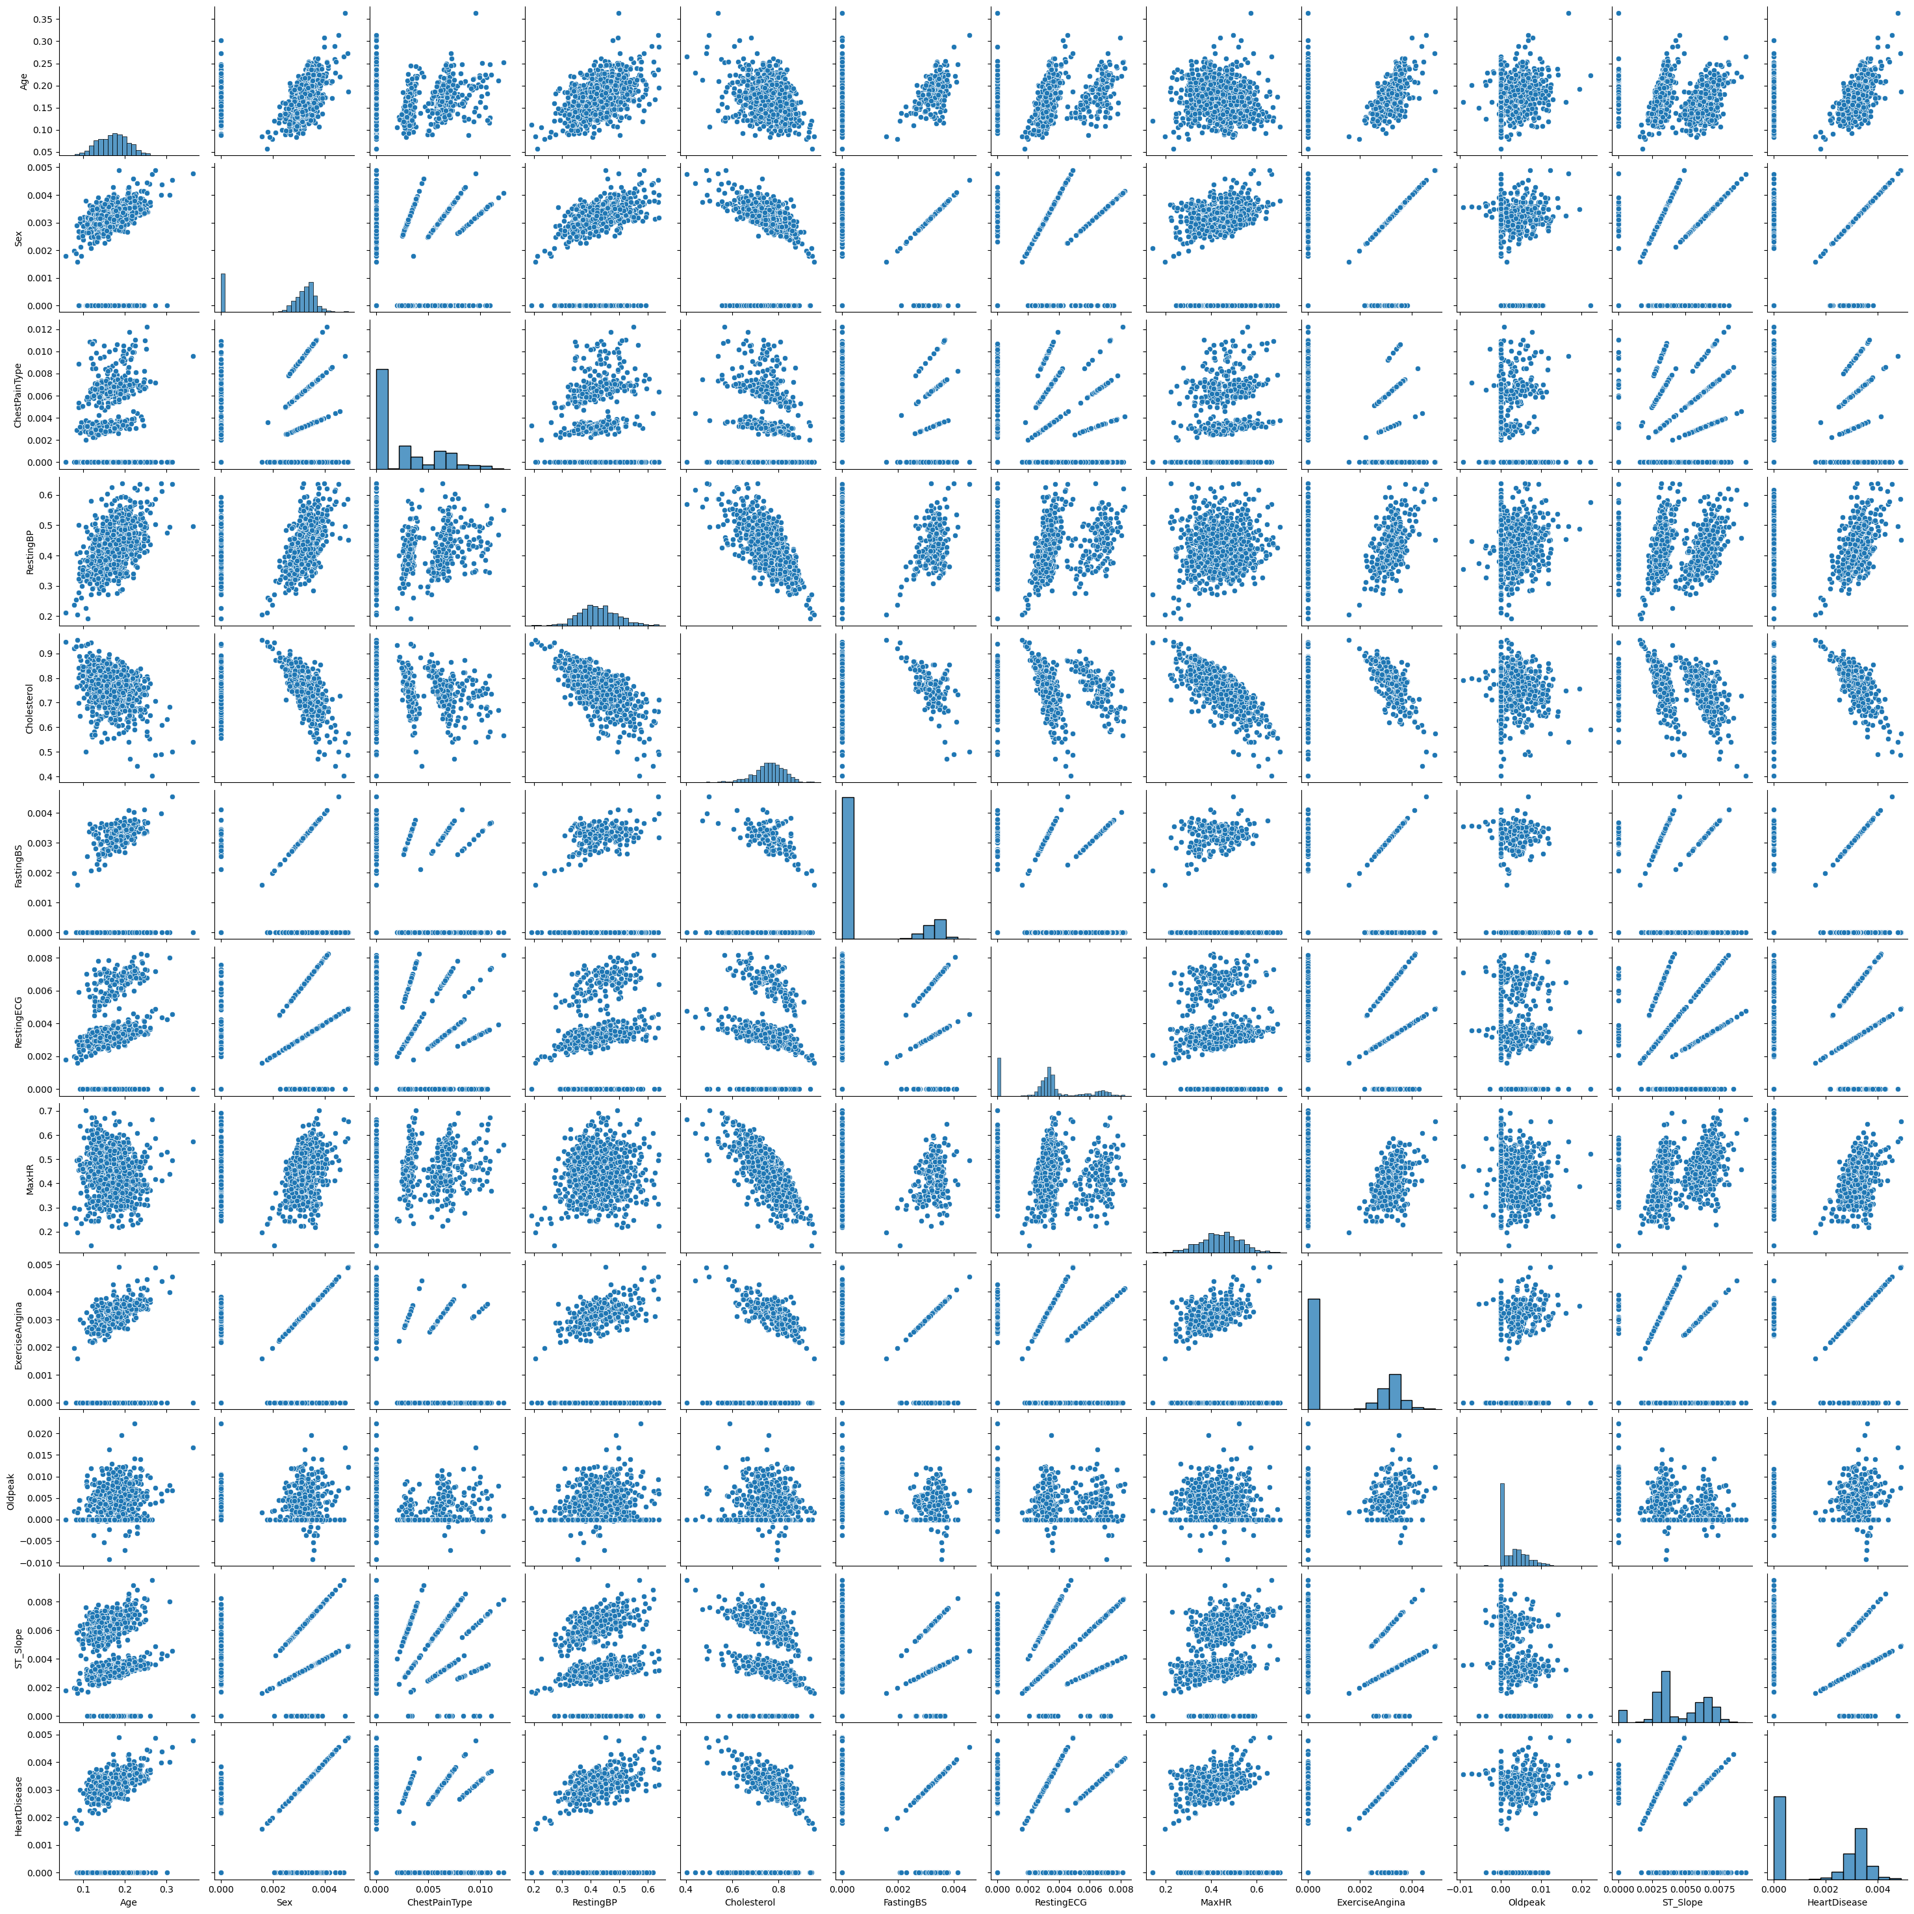
Data Normalization

Slide 25
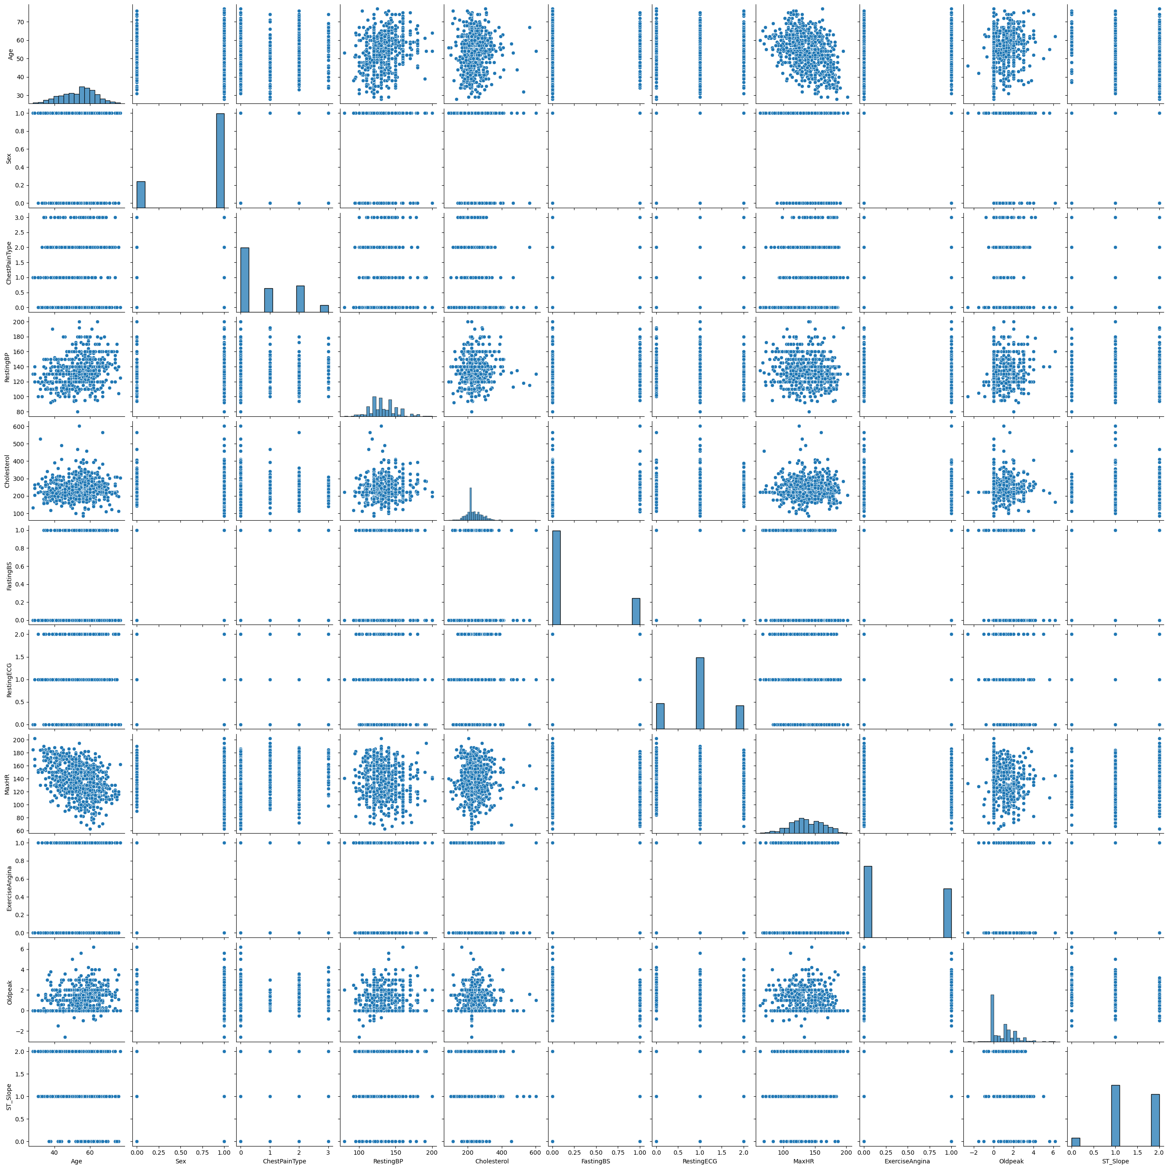
Data Scaling

Slide 26
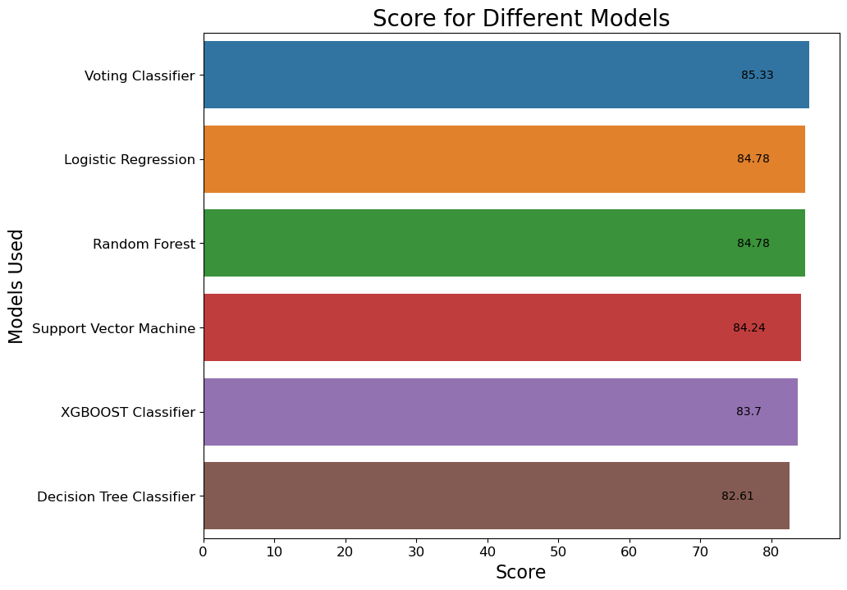
Comparison Between Classification Model

Slide 27
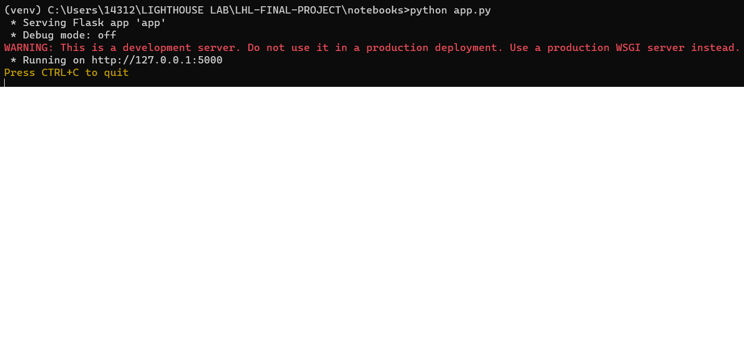
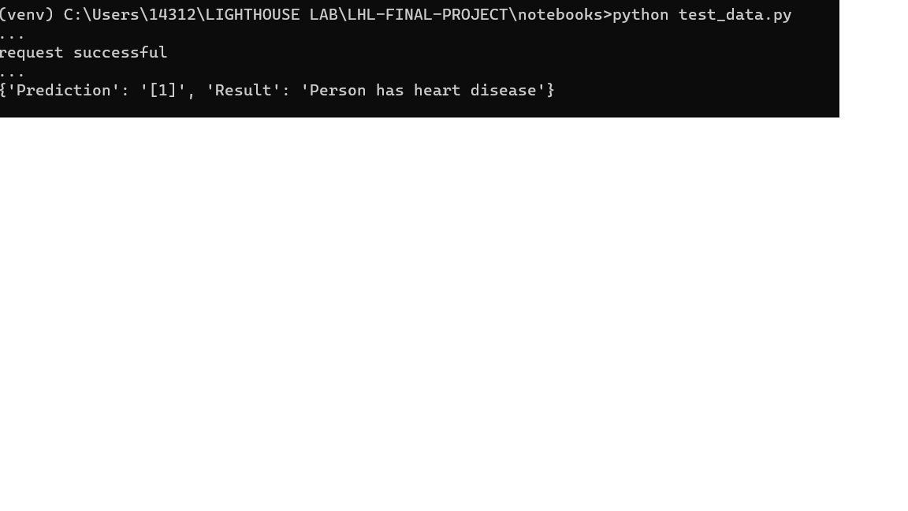
Flask App
The output of app.py file
The output of test_data.py which in JSON format.

Slide 28
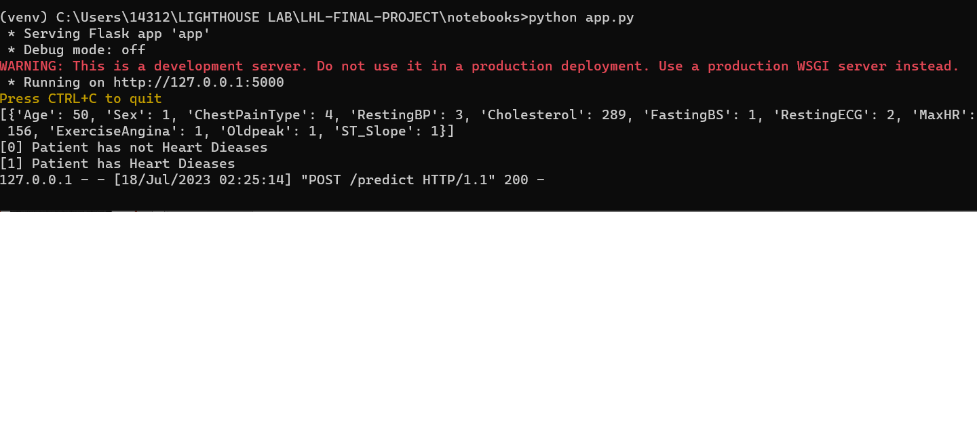
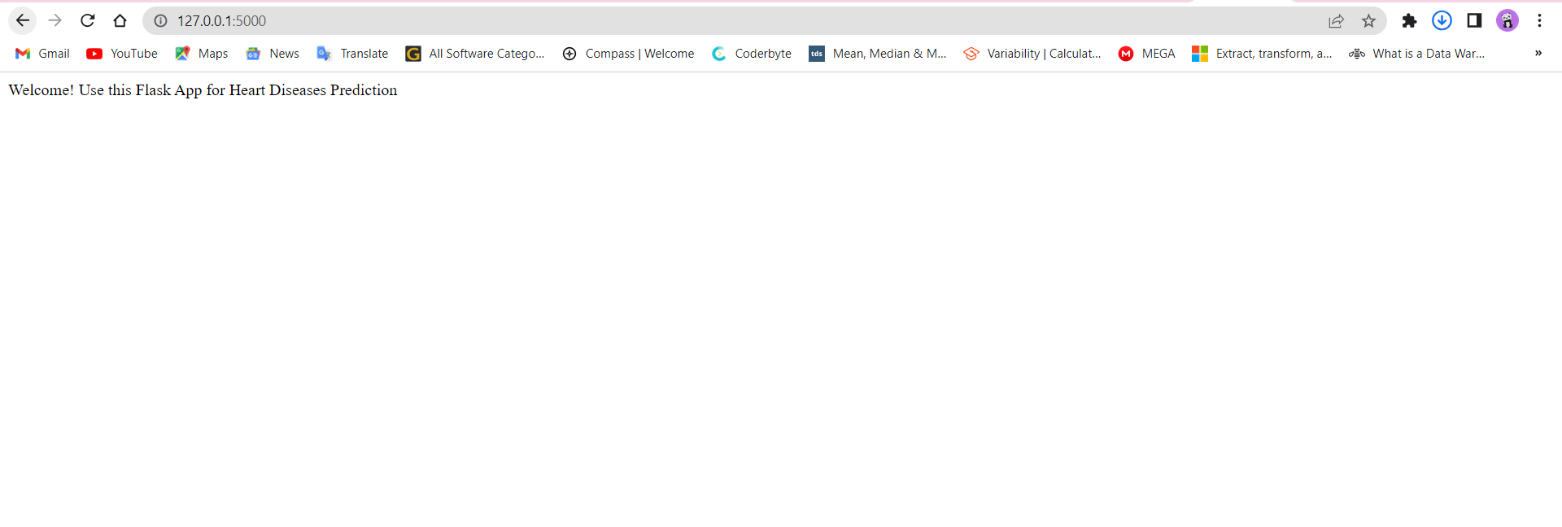
Flask application running on Google chrome browser.

Slide 29
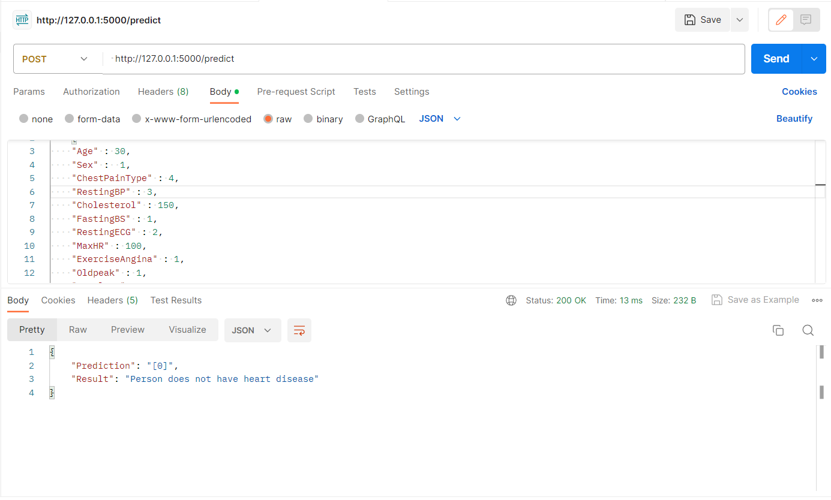
Flask application run on Postman using the post method.

Slide 30
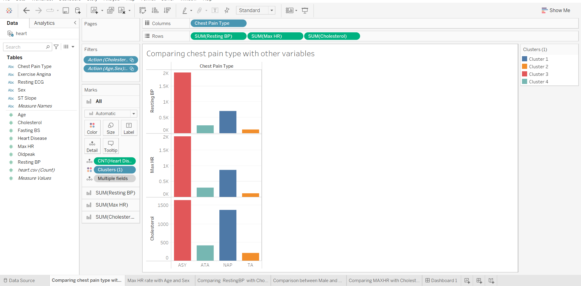
Tableau Visualization

Slide 31
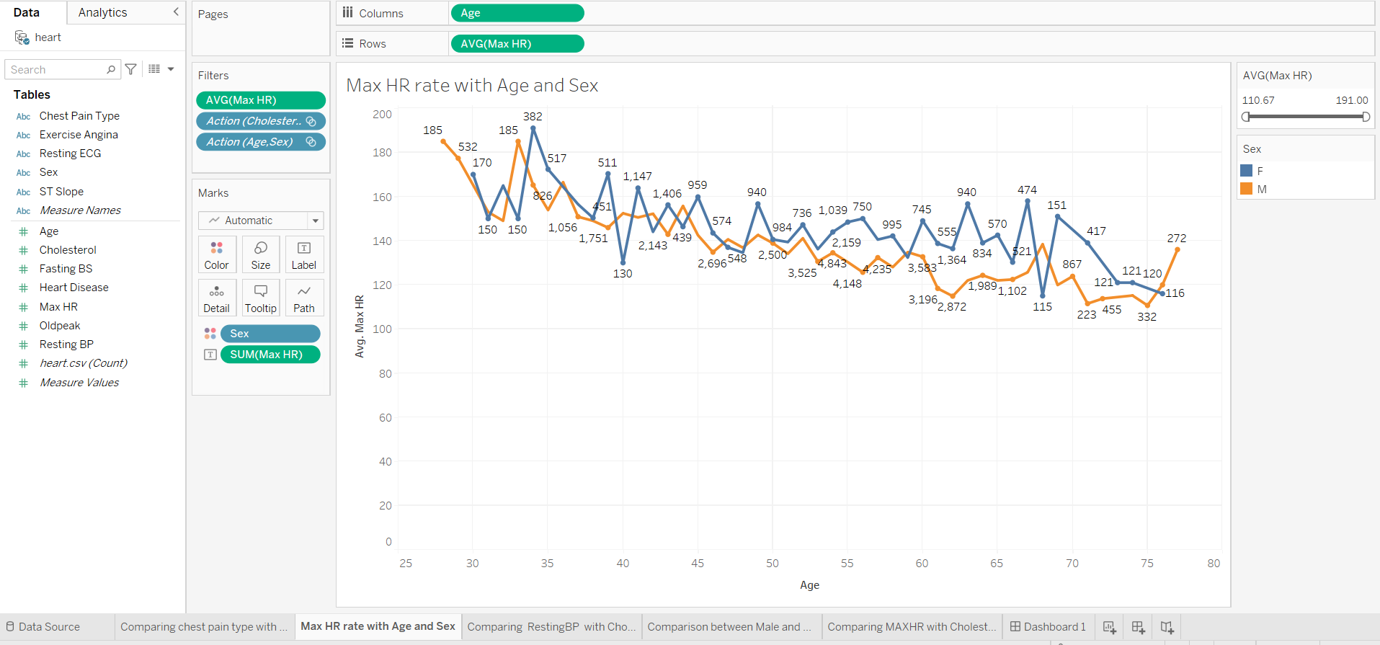

Slide 32
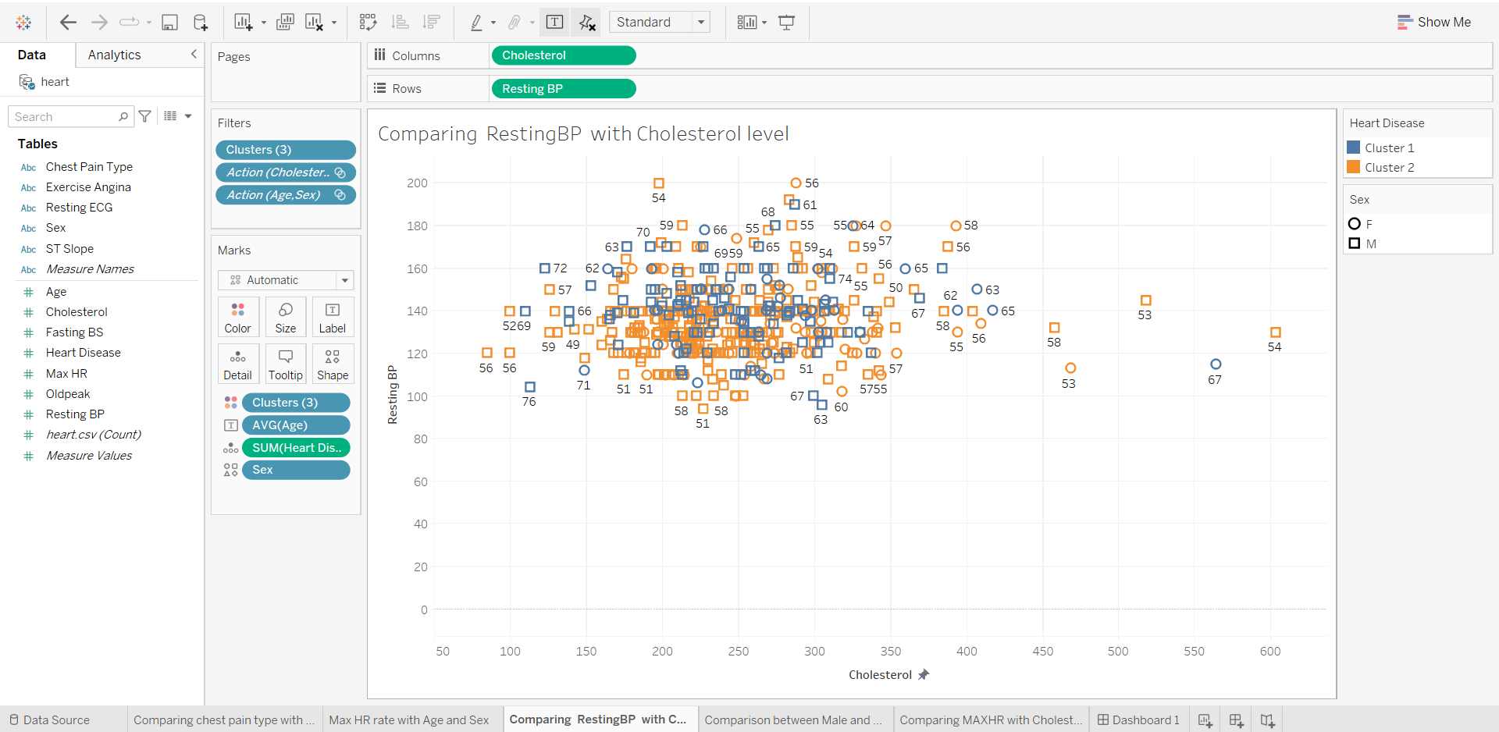

Slide 33
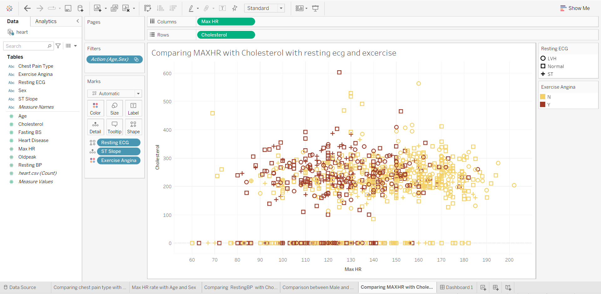

Slide 34
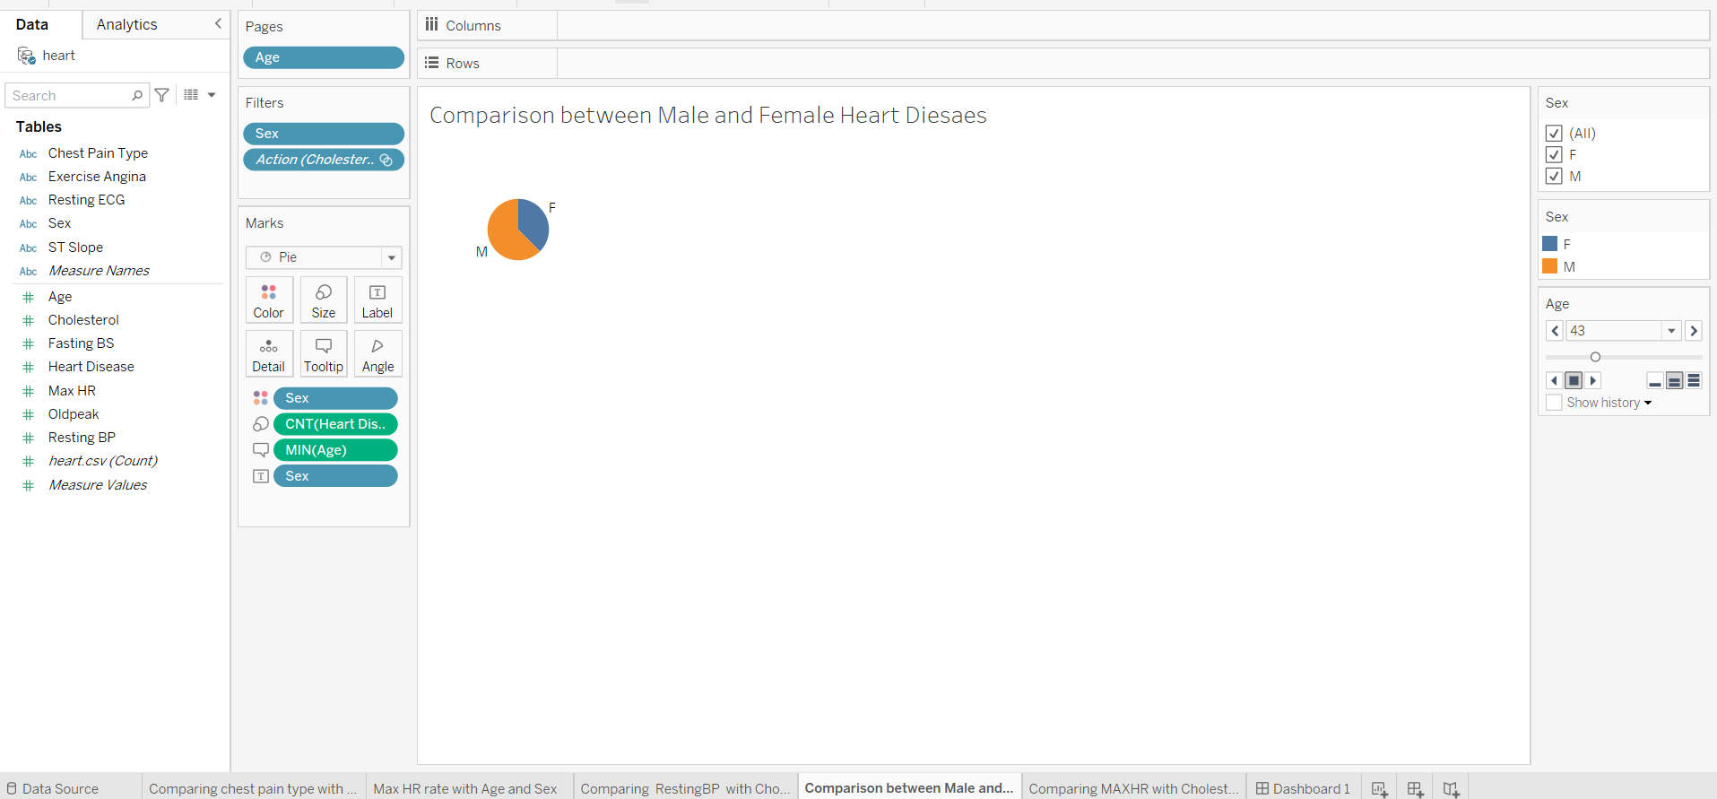

Slide 35
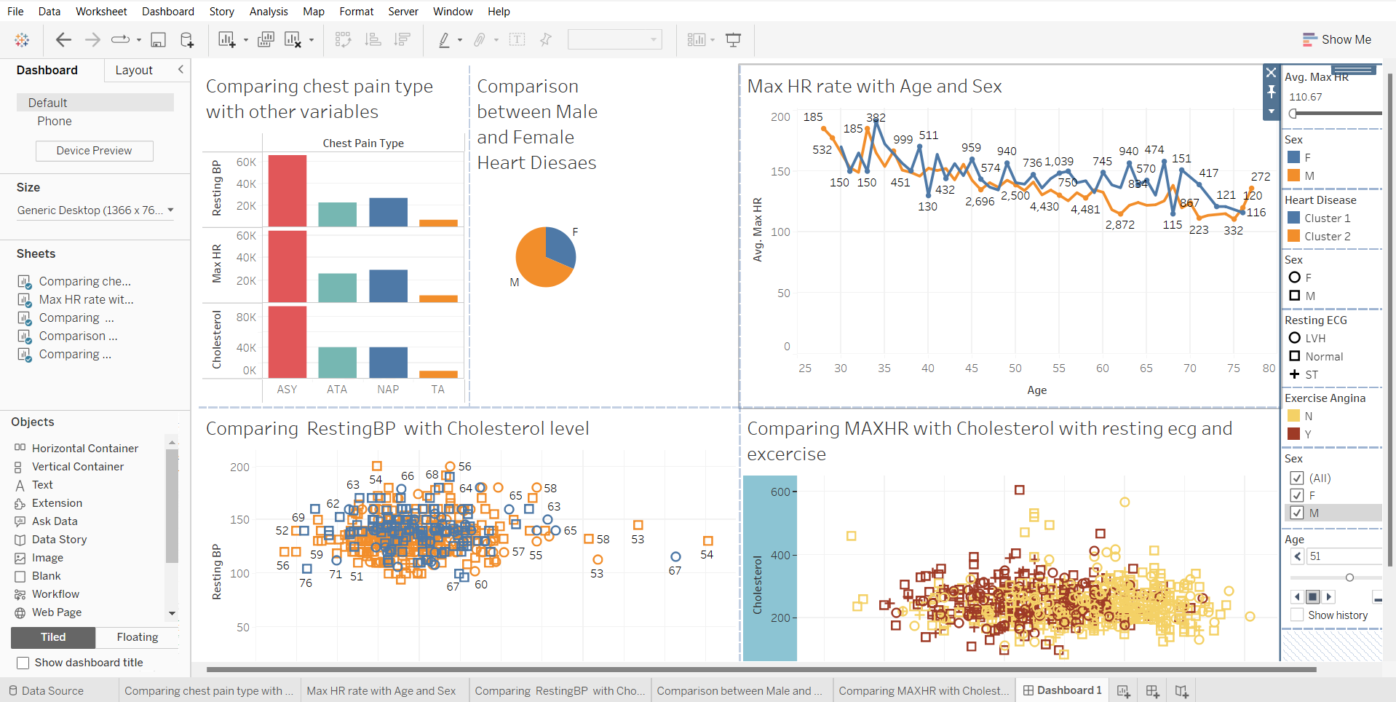

Slide 36
Thank You

